Slide 1




Predicting Breast Cancer Classifications through Exploratory Data Analysis and Supervised Machine Learning
DTSA 5509 Final Project
Rachel VanOsdol
October, 2023

Slide 2

Project Description:
Breast cancer is a critical healthcare concern, and accurate classification is pivotal for timely diagnosis and effective treatment. In this exploratory data analysis project, machine learning techniques such as logistic regression and support vector machines are used to predict breast cancer classifications with precision.
The breast-cancer.csv dataset used in this EDA is available on Kaggle:
https://www.kaggle.com/datasets/yasserh/breast-cancer-dataset
This Photo by Unknown Author is licensed under CC BY-NC

Slide 3
id: Unique ID for each observation.
diagnosis: The target variable that classifies the tumor as either "M" for Malignant or "B" for Benign.
radius_mean: The mean of distances from the center of the tumor to points on its perimeter. It represents the average size of the radius of the tumor.
texture_mean: A measure of the variation in grayscale intensity in the image, which reflects the texture of the tumor.
perimeter_mean: The average circumference or length of the tumor's boundary.
area_mean: The average size of the tumor's area, calculated as π times the square of the radius_mean.
smoothness_mean: A measure of the smoothness of the tumor's boundary. It quantifies how irregular or rough the tumor's perimeter is.
compactness_mean: Combines information about the perimeter and area to describe the compactness or shape of the tumor.
concavity_mean: Measures the severity of concave portions of the tumor boundary. It quantifies the presence of inward dents or hollow areas.
concave points_mean: The number of concave points or inflection points on the tumor's boundary.
symmetry_mean: A measure of symmetry in the tumor's shape.
fractal_dimension_mean: A measure of the complexity of the tumor's boundary, often used for characterizing irregular shapes.
radius_se: The standard error of the radius, providing information about the variability of the radius measurements.
texture_se: The standard error of the texture measurements, indicating the variability in texture across samples.
perimeter_se: The standard error of the perimeter measurements, providing information about the variability in perimeter estimates.
area_se: The standard error of the area measurements, indicating the variability in area estimates.
smoothness_se: The standard error of the smoothness measurements, reflecting the variability in smoothness.
compactness_se: The standard error of the compactness measurements, indicating the variability in compactness.
concavity_se: The standard error of the concavity measurements, reflecting variability in concave portions.
concave points_se: The standard error of the number of concave points, providing information about variability in inflection points.
symmetry_se: The standard error of the symmetry measurements, indicating variability in symmetry.
fractal_dimension_se: The standard error of the fractal dimension measurements, reflecting variability in complexity.
radius_worst: The "worst" or largest mean value of the tumor's radius among measurements from various images or samples.
texture_worst: The "worst" or largest mean value of texture among measurements from various images or samples.
perimeter_worst: The "worst" or largest mean value of the tumor's perimeter among measurements from various images or samples.
area_worst: The "worst" or largest mean value of the tumor's area among measurements from various images or samples.
smoothness_worst: The "worst" or largest mean value of smoothness among measurements from various images or samples.
compactness_worst: The "worst" or largest mean value of compactness among measurements from various images or samples.
concavity_worst: The "worst" or largest mean value of concavity among measurements from various images or samples.
concave points_worst: The "worst" or largest mean value of concave points among measurements from various images or samples.
symmetry_worst: The "worst" or largest mean value of symmetry among measurements from various images or samples.
fractal_dimension_worst: The "worst" or largest mean value of fractal dimension among measurements from various images or samples.
Data Overview
32 columns (30 of which are features)
569 Rows (observations)
Notes:
This an overview of the data.
There are 32 columns (30 of which are features)
And 569 observations.
Each row or observation represents a breast tumor. The target variable, "diagnosis" classifies the tumor as either "M" for Malignant or "B" for Benign. I encoded these as 1 and 0 respectively,
The other features provides valuable information about the shape, size, texture, and other properties of the tumors. These features are often extracted from images or other diagnostic tests.
Since the name of the features might be a little misleading, let me explain that…
The "worst" type variables represent the largest mean value of that feature among numerous measurements from various images or samples of a single tumor.
Similarly, the “mean” and “se” (or “standard error”) type features represent those statistics for that feature among measurements from various images or samples of a single tumor.

Slide 4
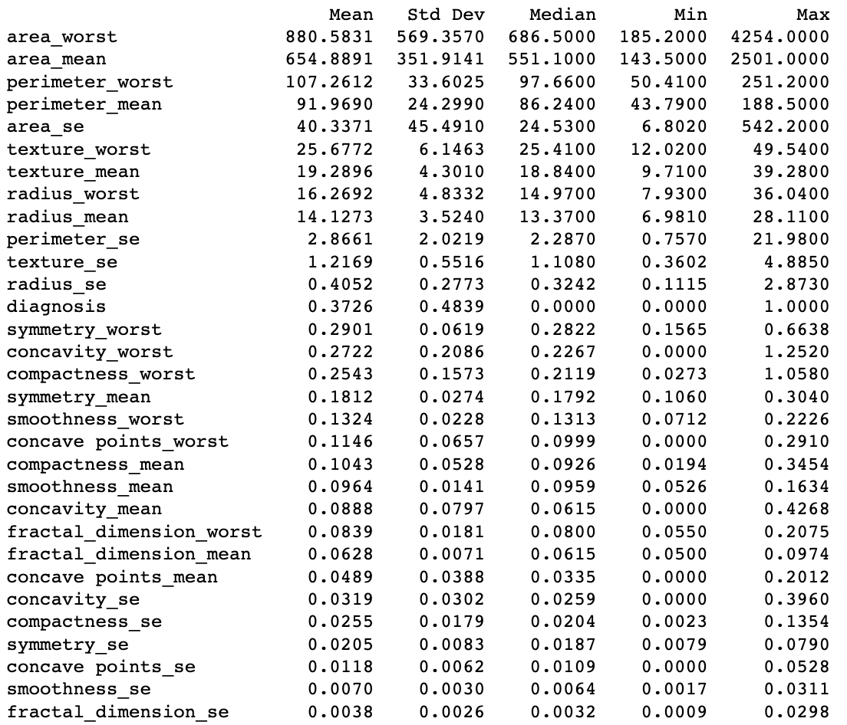
Notes:
After some data preprocessing, which you can review in my Jupyter notebook, I wanted to generate some summary statistics which are shown here, sorted in descending order of the feature mean values.
As you can see, the features exhibit significant variations in their scales, with the area and perimeter-related variables being notably larger in scale compared to the others. Considering this information, I decided to scale the features, before I split them into training and testing subsets, so that they all have a mean of 0 and a standard deviation of 1.

Slide 5
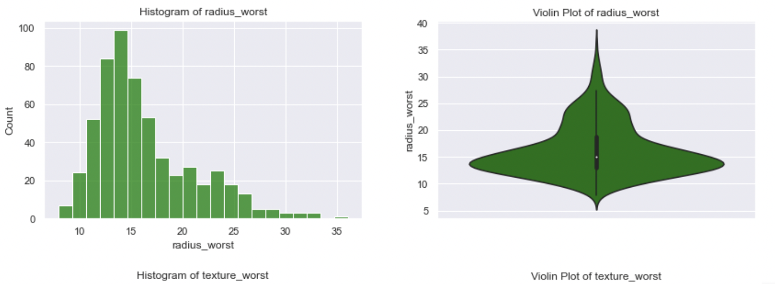
Notes:
I also generated histograms and violin plots for each feature, just to get a good idea of the feature distributions. Here is an example of those plots for just one of the features.

Slide 6
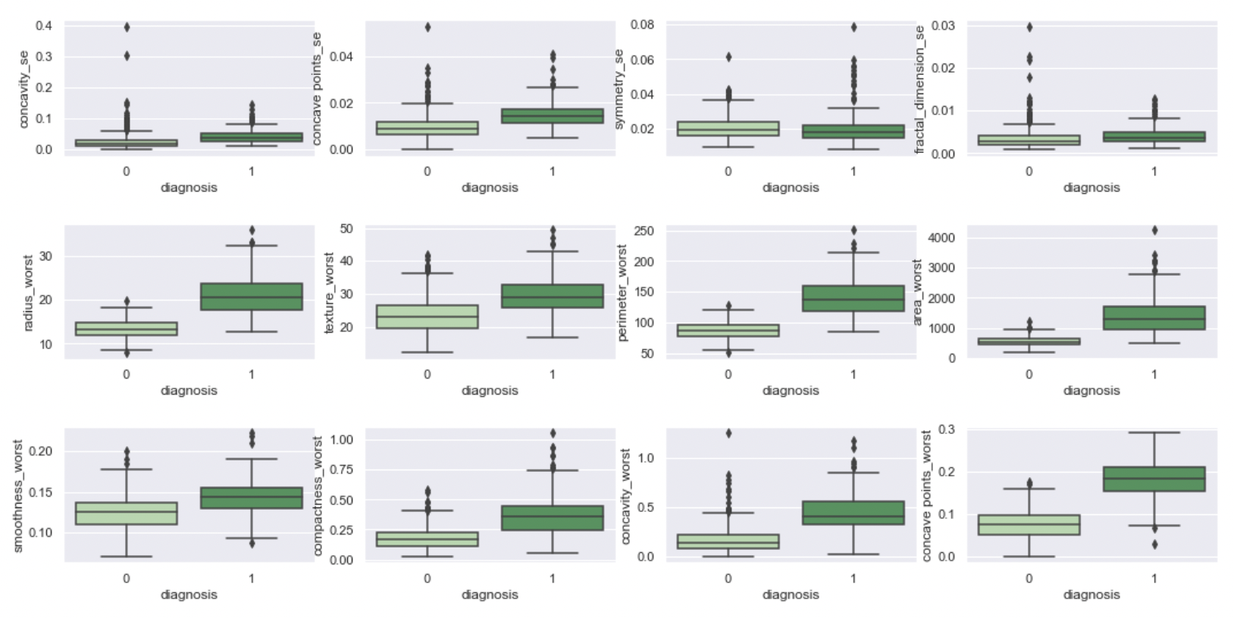
Notes:
I created box plots to visualize bivariate distributions with the target variable outcome. I found these to be a bit more helpful in anticipating which features will be more important (or… impactful) in predicting the outcome.

Slide 7
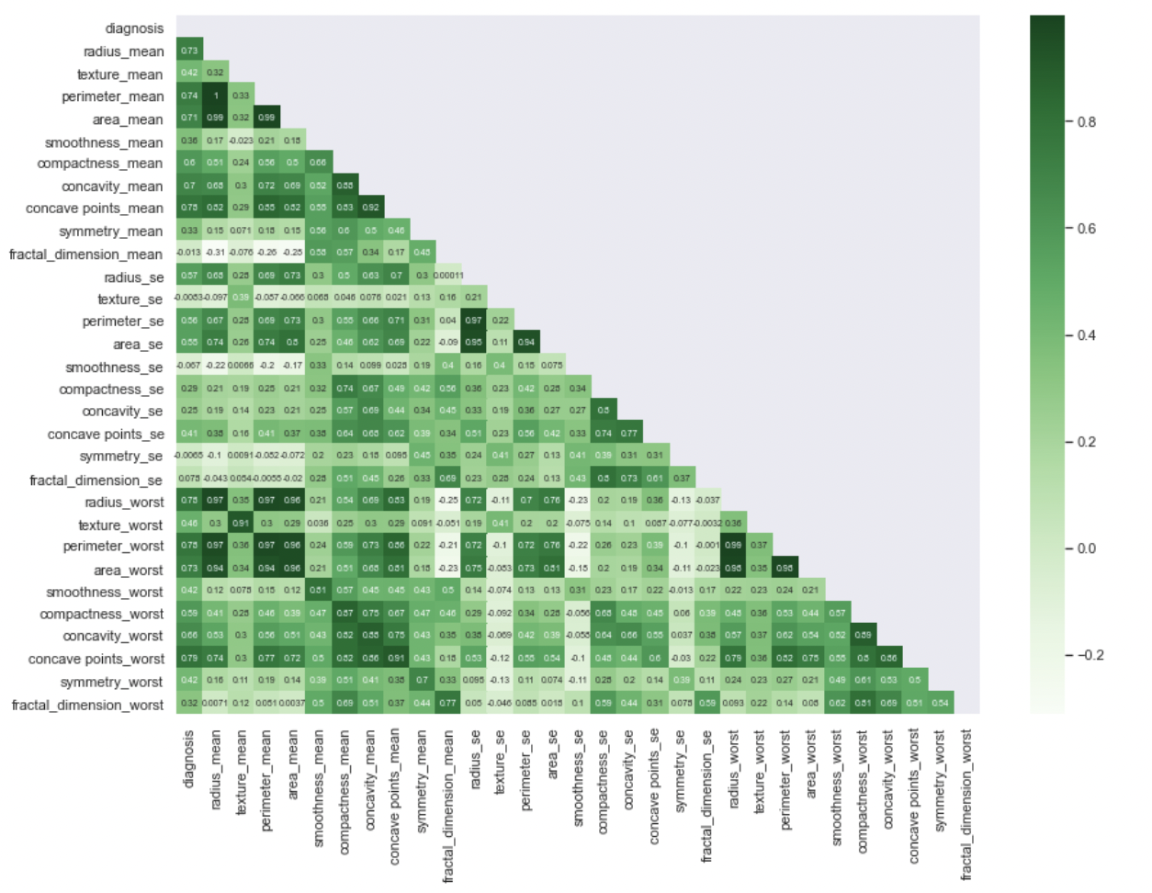
Notes:
And of course I created a handy-dandy correlation matrix, because who wouldn’t? Now I realize, since there are so many features, that this is rather hard to see, you can get a closer look upon reviewing my jupyter notebook, but hopefully the colors help you to discern that there are definitely some features that are highly correlated with each other. This is kinda expected since a lot of these features are measurements like radius, perimeter, and area, which depending on the shape of the tumor, these features may not always have a linear relationship, but I would guess that it is usually linear…

Slide 8
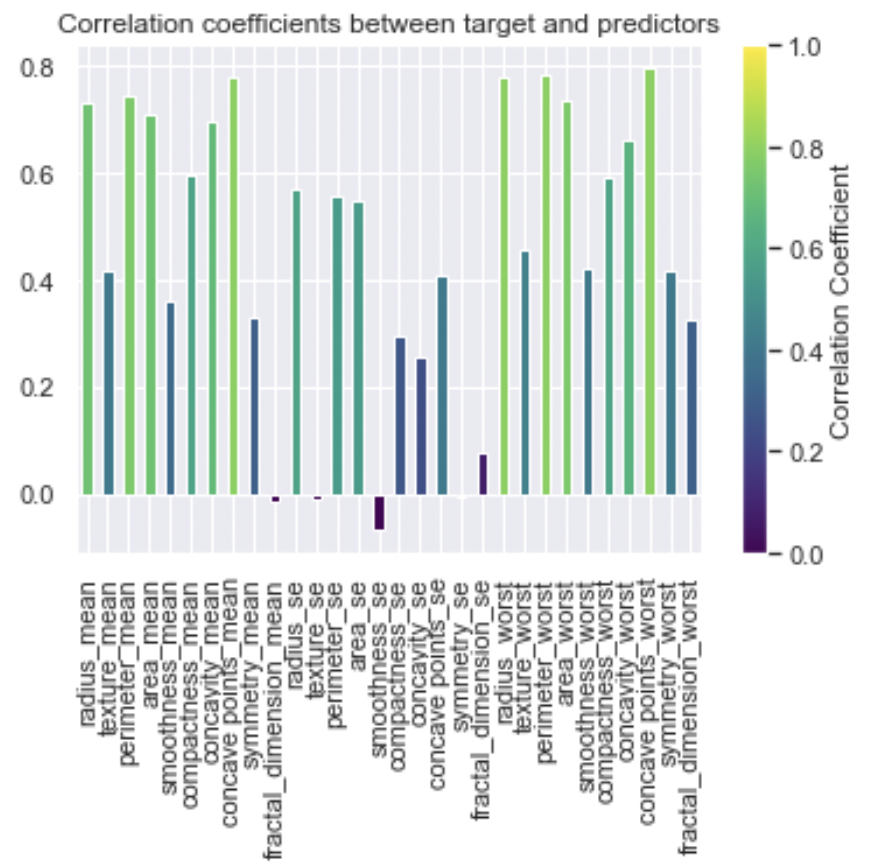
Notes:
Here, we are looking specifically at the correlation coefficients between the target variable and all the features. This looks promising, since the target variable seems to be highly correlated with several features.
Particularly the “mean” and the “worst” type of features,

Slide 9
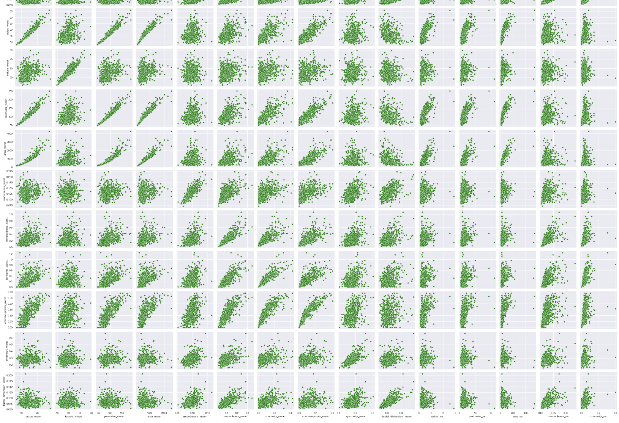
Notes:
I created a pair plot to see what kind of relationships there might be among the features. I couldn’t reasonably fit the entire pairs plot figure here, so this is just a subset of the plot just to show you that there are indications of some type of relationship, probably a linear relationship, among the features within this dataset.

Slide 10
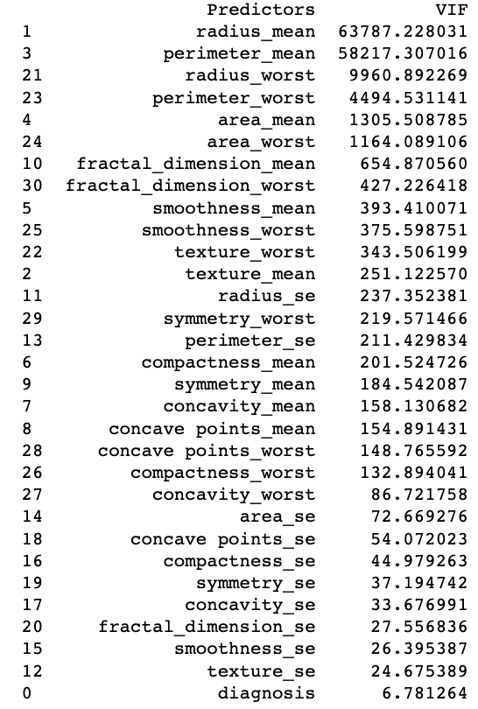
Variance Inflation Factor (VIF)
VIF = 1 / (1 - R²)
R² is the coefficient of determination obtained by regressing the predictor variable against all the other predictor variables in the model.
Notes:
Since a lot of these feature are highly correlated, I wanted to calculate the Variance Inflation Factor for each feature. A VIF essentially quantifies the extent to which each predictor variable can be predicted or explained by the other predictor variables. So It assesses the degree of linear dependence among predictors.
As a general guideline, it's recommended that the VIF's should not exceed 5, as values greater than this threshold indicate a high level of multicollinearity.
Given that the VIF values exceed 5 for every feature, it can be reasonably inferred that this dataset exhibits a significant degree of multicollinearity.

Slide 11
Model Selection
Trained two models and compare their performance
Logistic regression: This model could face challenges related to high dimensionality and multicollinearity. A potential solution is to employ Lasso regularization methods.
SVM: This model exhibits reduced sensitivity to multicollinearity, particularly when using non-linear SVMs like RBF kernels.

Slide 12
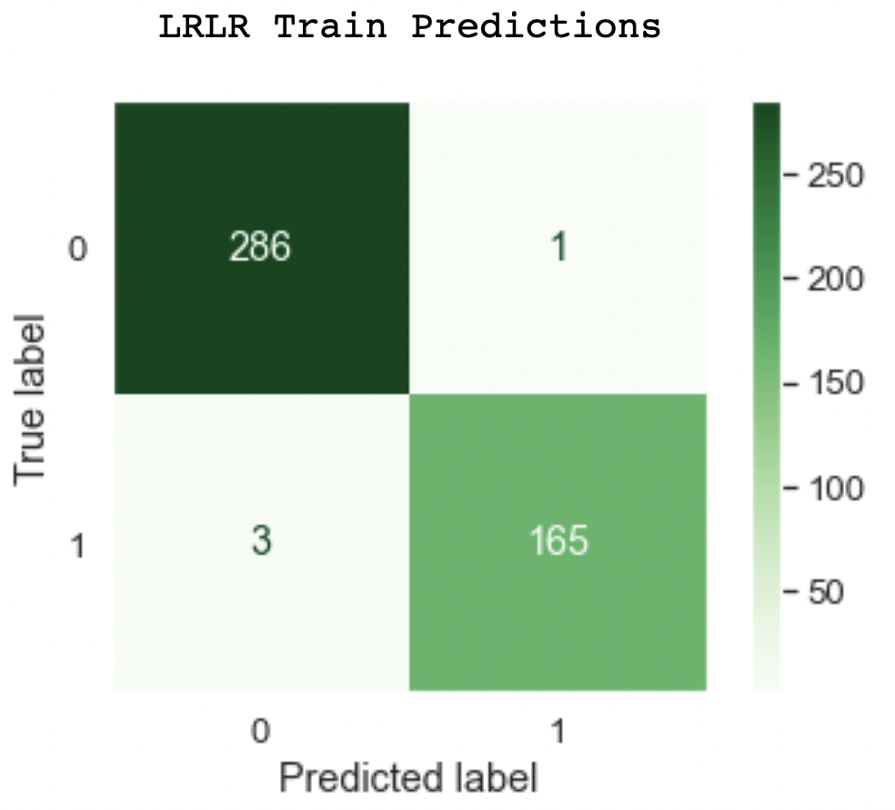
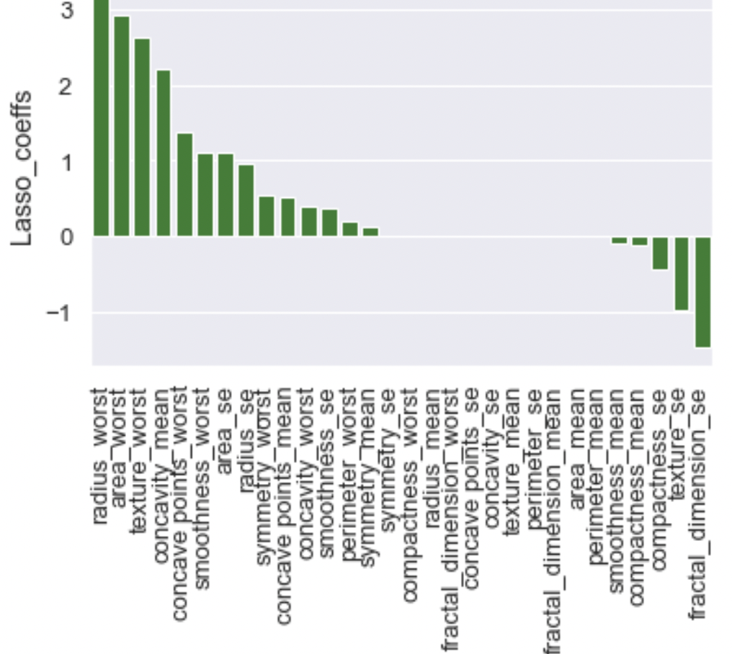
z
Model Training
Logistic Regression with Lasso Regularization (LRLR)
The training data (80% of the original data, selected randomly) was used to train the model
GridSearchCV was used to determine the optimal model parameters and perform k-fold cross validation
Trained model results:
Best C: 2.154
Best score: 0. 97367
Classifications: Benign = 0, Malignant = 1
Which features are important?
the average VIF of the lasso-removed features is greater than the average VIF of the lasso-kept features
Notes:
I split the data into a training and test set, and used the training data to train the model.
I used the GridSearchCV function that we are already familiar with from the homework assignments. This gave me an optimal value for the C parameter.
As you can see, the model’s accuracy on the training data is pretty good, with only four misclassified points, although the false negative rate is a little higher than I would like.
As for which features are important, that is, which features the lasso regularization process kept,
Generally, the “worst” type features seem to have the largest impact, and surprisingly, Lasso kept many of the standard error type features as well.
Just a quick notes on the lasso coefficients and the VIFs that were shown earlier, the average VIF of the lasso-removed features is greater than the average VIF of the lasso-kept features, which suggests that Lasso regularization effectively identified and removed features that had a higher degree of multicollinearity.

Slide 13
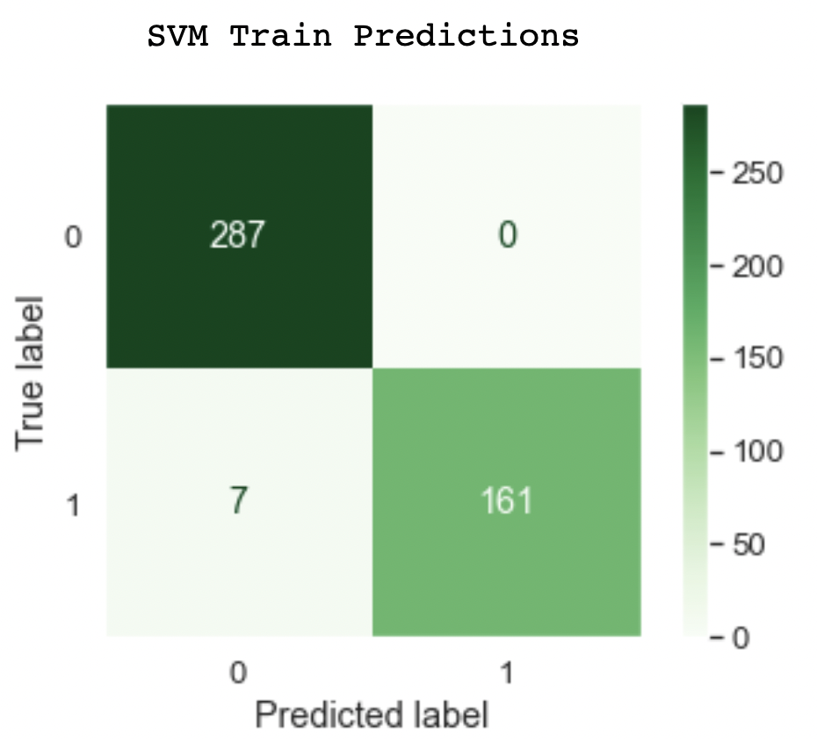
z
Model Training
Support Vector Machine with a Radial Basis Function Kernel (SVM)
GridSearchCV was used to determine the optimal model parameters and perform k-fold cross validation
Trained model results:
Best C: 2
Best Gamma: 0.03125
Best score: 0.97357
Classifications: Benign = 0, Malignant = 1
Over 90 Support vectors
Notes:
On to the SVM!
This model’s accuracy at predicting the outcome on the training data was just slightly worse than it was for the previous model, but still not horrible. The false positive rate is slightly larger.
So what about feature importance?
How can I determine that? One approach is through support vector analysis. By thoroughly examining the distribution and characteristics of the support vectors, maybe I could gain some insight about the features that most significantly influence the model's decision-making process... But…
There are over 90 support vectors… and each support vector represents 30 of these tumor features, so analyzing the characteristics of these support vectors just didn’t seem feasible.

Slide 14
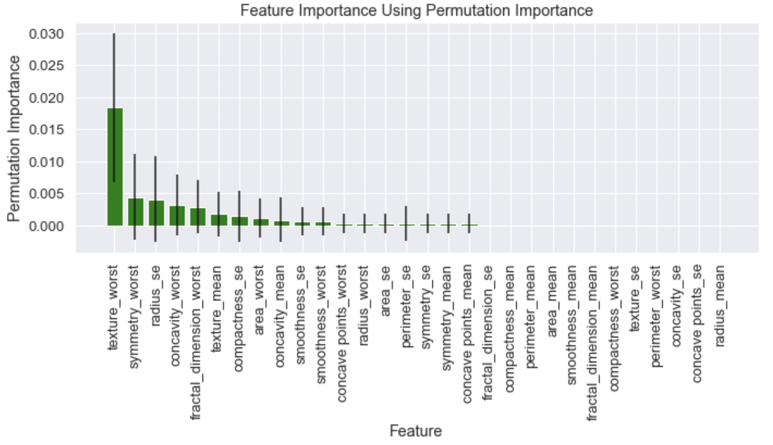
SVM: Which features are important?
Notes:
So! Instead, I use the permutation_importance function from the scikit-learn library
I have left detailed notes in my Jupyter notebook about how this works, but basically, what you see here… Each bar represents the permutation importance of a feature, and the error bars show the standard deviation of those importance values.
Features with higher permutation importance values are more influential in making predictions, while those with lower values are less influential.
Similar to the Log reg model, the “worst” type features seem to stand out (particularly the texture_worst feature), as well as some standard error type features.

Slide 15
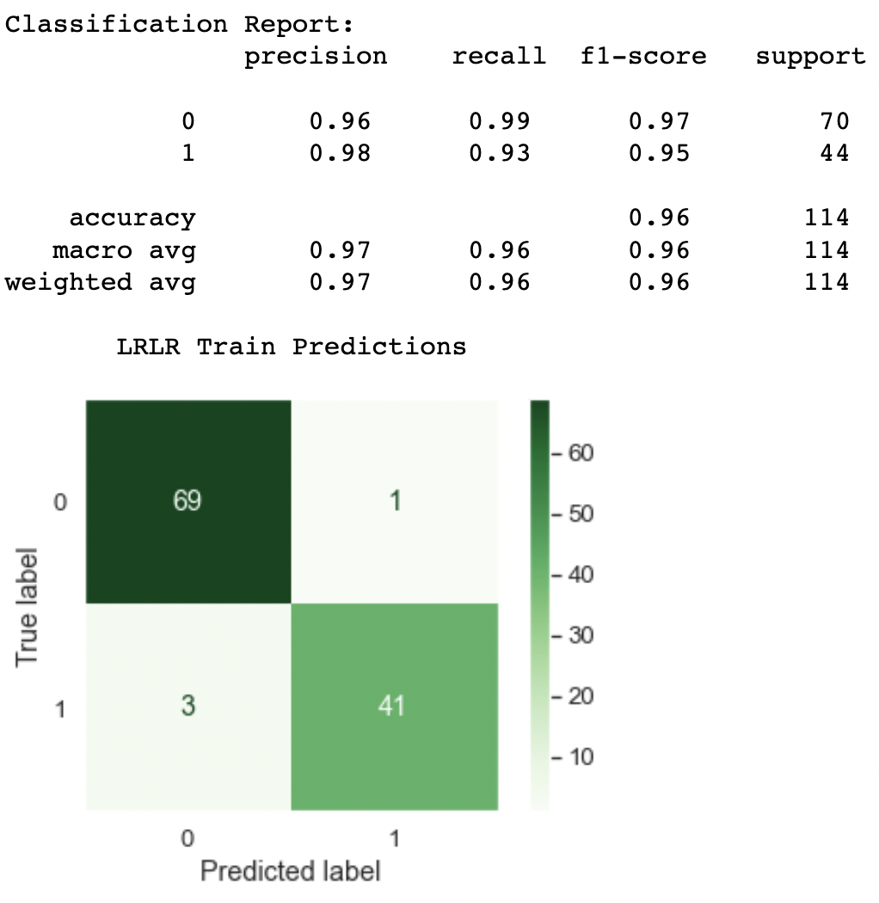
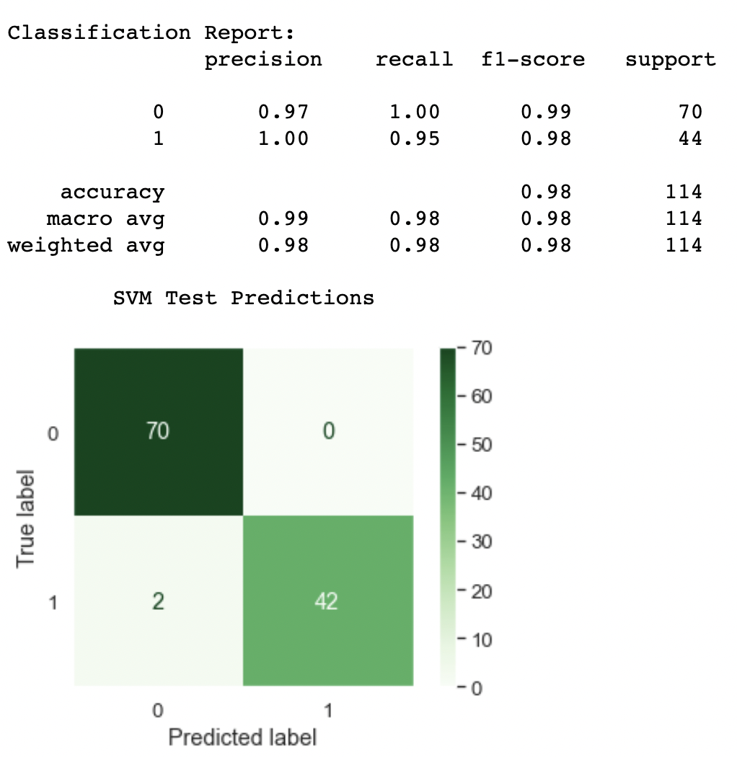
Model Validation
Loss = - (1/N) * ∑[y_i * log(p_i) + (1 - y_i) * log(1 - p_i)]
LRLR Log Loss: 1.2119 SVM Log Loss: 0.6059
Notes:
Now for the model validation!
What I show here is the classification report and the confusion matrix for each models’ performance on the testing data.
The accuracy of the logistic regression model is approximately the same as it was for the training data, however the SVM seemed to preform better on the testing data that it did on the training data.
I have also computed the Log-loss value for each model, as we did in our homework.
A log loss value of 1.21 suggests that, on average, the model's predicted probabilities are not a perfect match for the actual outcomes.
A log loss value of 0.61 is better, but there is still some level of error.

Slide 16
Conclusion
Both models often highlight features with "worst" or largest mean values, such as "texture_worst," as particularly important.
Despite both models exhibiting equal accuracy, Logistic Regression with Lasso's feature selection might facilitate improved generalization, especially when handling new, unseen data, thanks to its pre-identified subset of influential features.
However, due to the sever consequence of misclassification for this particular problem, I would hesitate to deploy these models as they are to be used to diagnose a breast tumor as benign or malignant.
This Photo by Unknown Author is licensed under CC BY-NC
Notes:
Both models often highlight features with the "worst" type features, such as "texture_worst," as particularly important.
Despite both models exhibiting equal accuracy, Logistic Regression with Lasso's feature selection might facilitate improved generalization, especially when handling new, unseen data, thanks to its pre-identified subset of influential features.
However, remember this problem is about predicting breast tumor classification to allow for informed decisions about treatment. Due to the sever consequence of misclassification for this particular problem, I would hesitate to deploy these models, at least as they are now, to be used to diagnose a breast tumor as benign or malignant.

Slide 17
References
DTSA 5509 Course materials
James, Gareth, et al. An Introduction to Statistical Learning with Applications in R, second edition. Springer, 2013
Dataset: https://www.kaggle.com/datasets/yasserh/breast-cancer-dataset
GitHub repo: https://github.com/rvanosdol/BreastCancerPredictions
This Photo by Unknown Author is licensed under CC BY-NC

